Slide 1
Classifying Gender Using Audio
Group 23

Slide 2

Motivation
Personalisation of Applications
Targeted advertisements
Call Centers

Slide 3
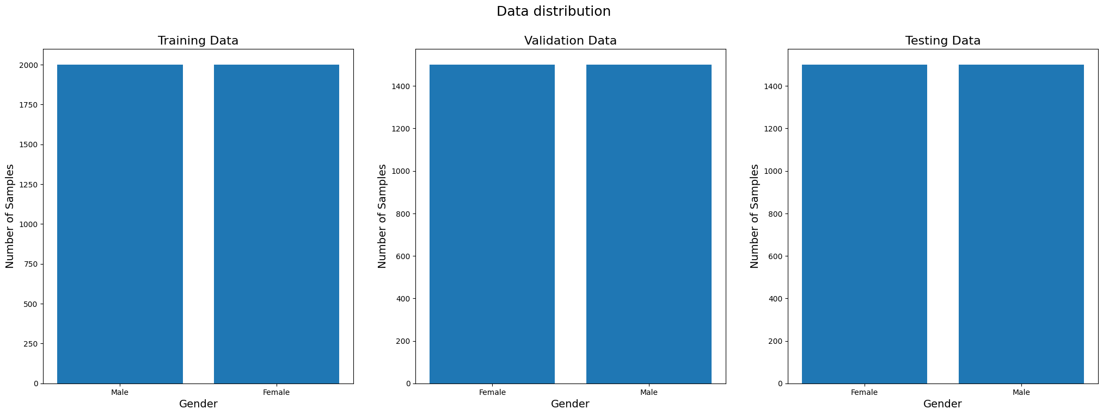
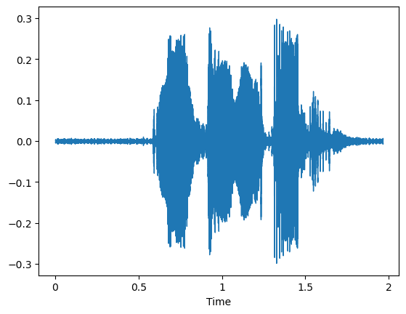

Data
LibriSpeech Dataset
Trim Silent Edges
Clipped to 5 seconds
10,000 balanced samples
40/30/30 Split
Label
→ F

Slide 4
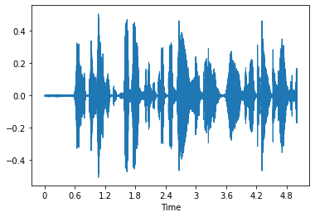
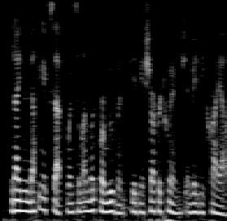
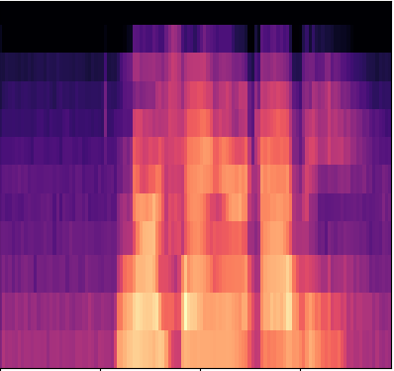
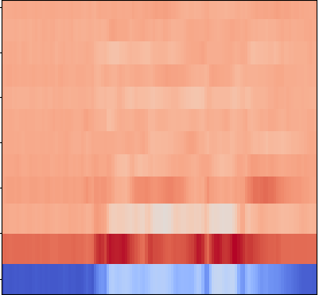
Method
Waveform + VGG (160 000)
Mel Spectrogram + ResNet (128, 128)
Mel Spectrogram + LSTM (313, 64)
MS, MFCC, ΔMFCC, PCEN + Random Forest

Slide 5

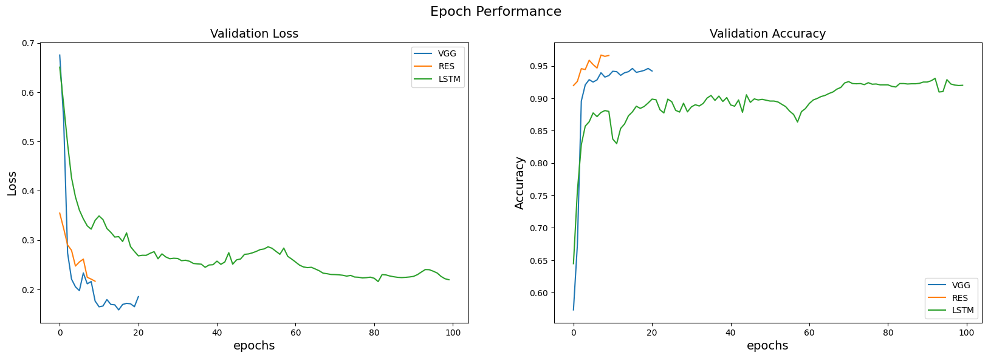
Results
NN Epoch Performance
Model Performance
Model | Training time (sec) | Testing Time (sec) | Accuracy (%) | F1 Score
Mel + ResNet | 1809.0 | 264.7 | 96.6 | 96.6
1D + VGGnet | 2476.3 | 164.7 | 94.4 | 94.6
Mel + LSTM | 1797.7 | 7.6 | 94.3 | 94.4
MFCC + RF | 202.3 | 0.63 | 58.0 | 58.2

Slide 6
Thanks for listening
By:
Sama Alkamachy (Absent)
Rafael Alves
Kevin Nguyen
Melissa Patson

